Slide 1




Cyclistic Bike-Share project-google data analytics capstone
By Brian Sampera
Data Analyst
May 2023

Slide 2

This company has a bicycle share system in Chicago, USA. The marketing team wants help analysing the data from a very dirty data frame. This will help drawing some conclusions regarding how to retain members and attract casual users to become members.

Slide 3
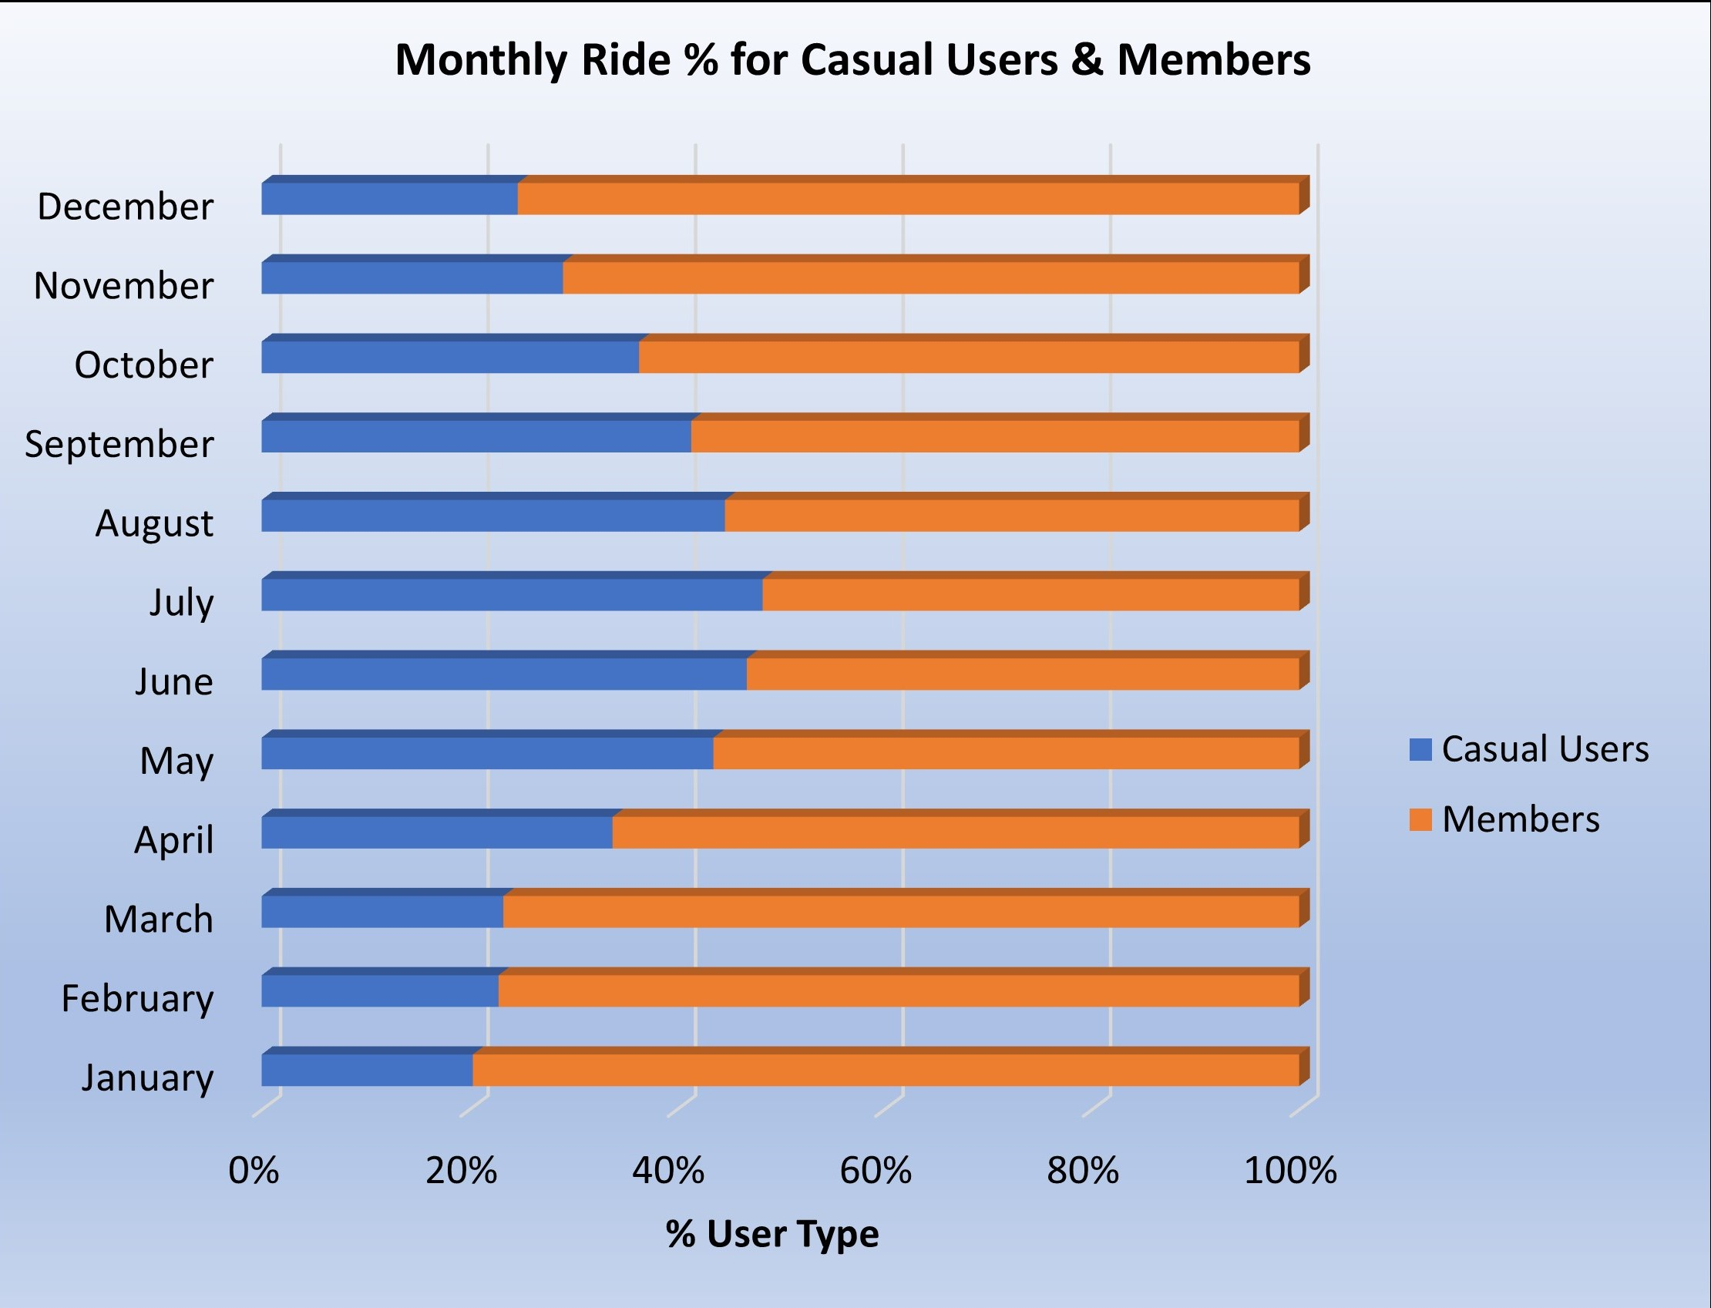
Types of users vs months of the year.
The clientele is mostly Members (average 70% throughout the year).
Casual user rides increase (double) during warmer seasons.

Slide 4
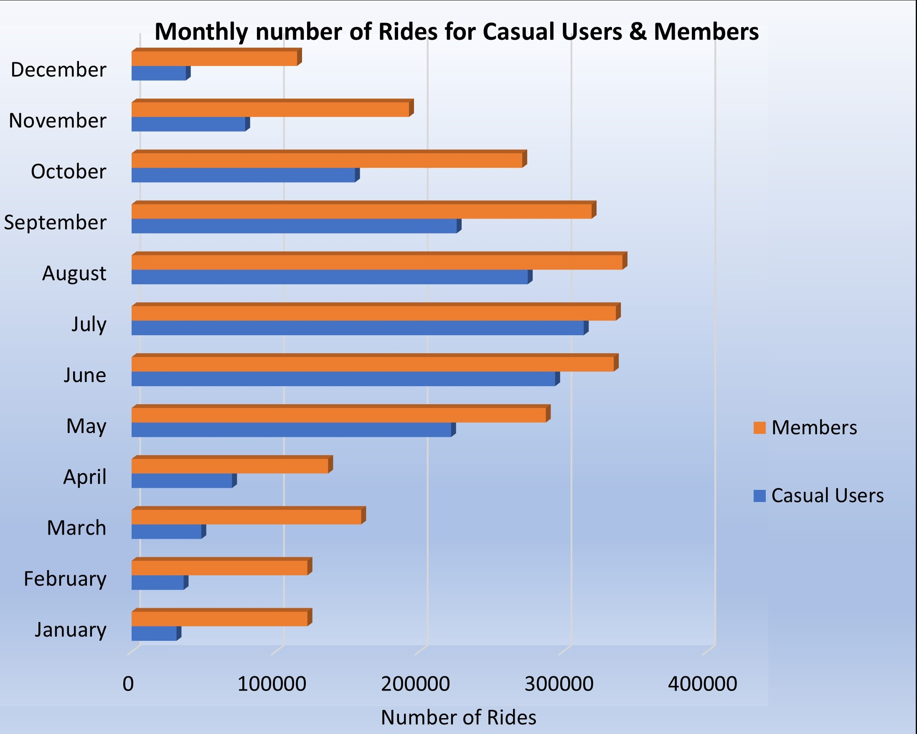
Monthly number of rides for user type
Bike rides increase significantly during the warm months.
The first third of the year is the slowest for business.
Casual users closely match members during summer.
Casual riders are very low during winter.

Slide 5
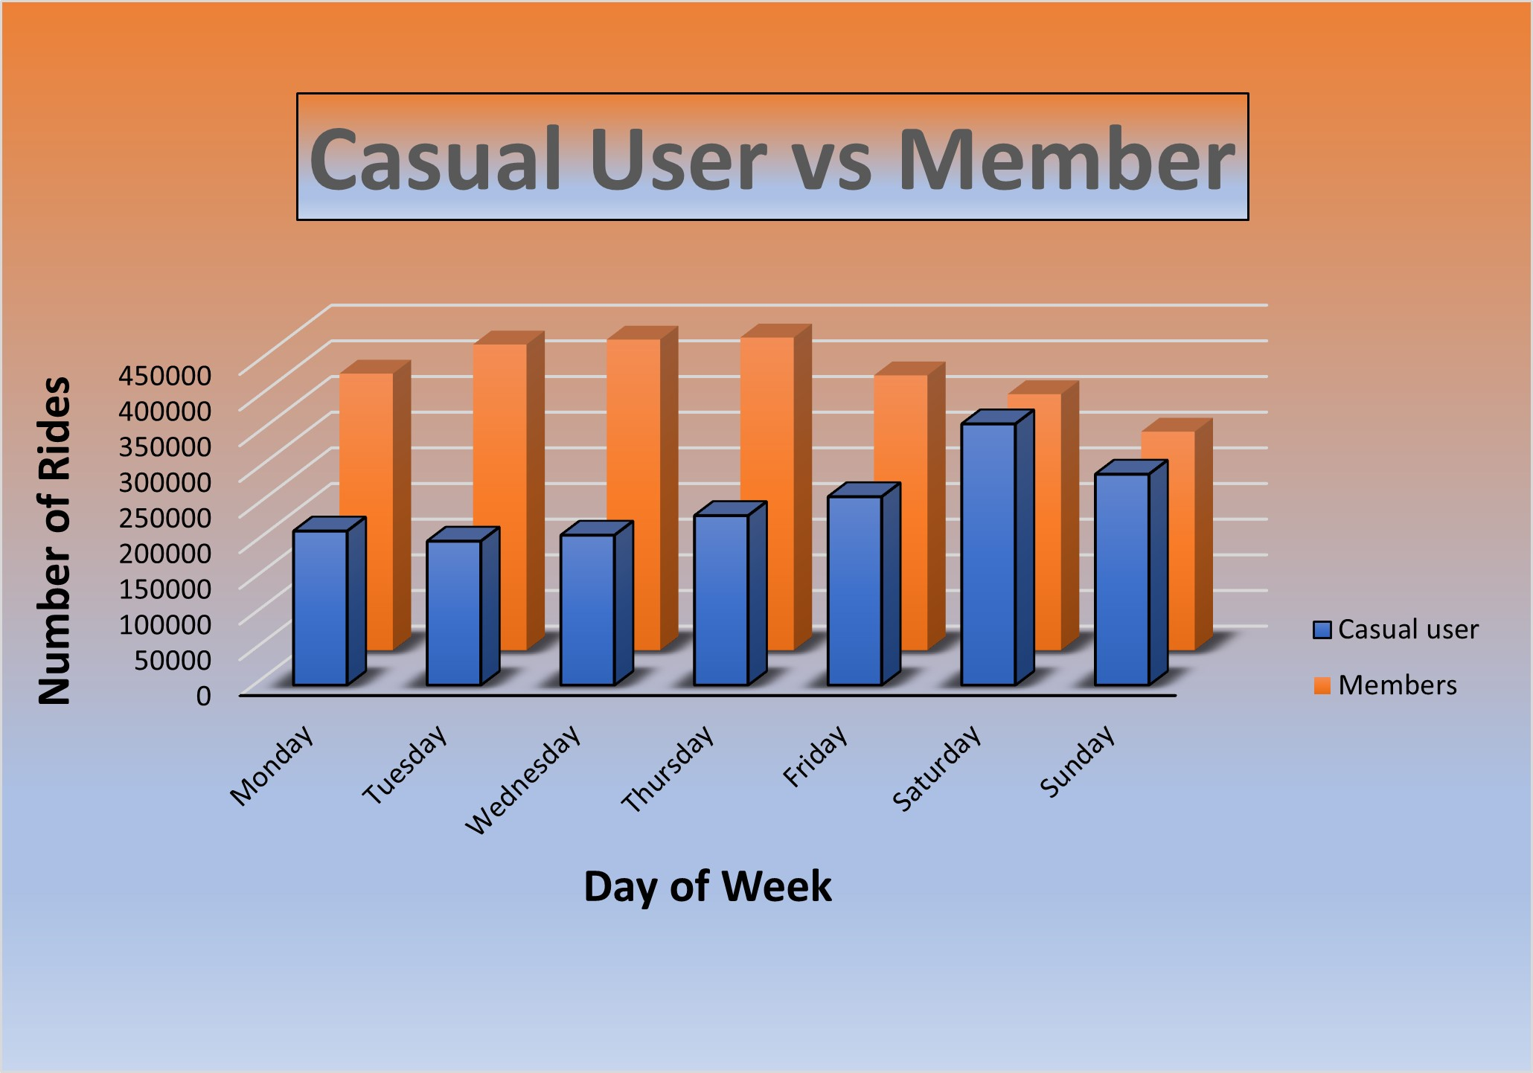
Weekly rides by user type
Members ride more during weekdays.
Casual Users ride almost double during the weekend.
Casual Users and Members ride almost equally during the weekends.

Slide 6
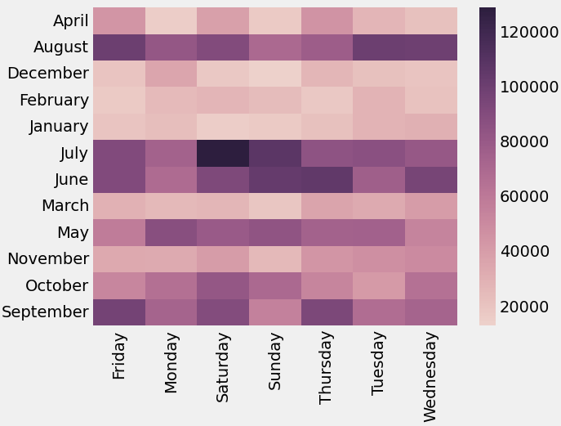
Heatmap (months vs days of week)
Saturdays in July are the most popular days of the year for riders.
Sundays during the winter months are the least popular days for riders.

Slide 7
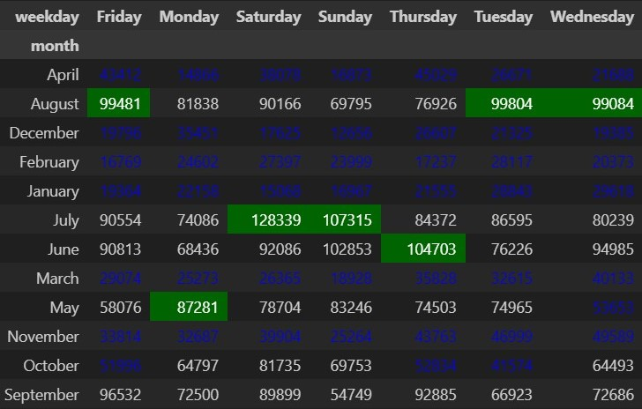
Average Ride lengths (seconds)
Items in blue represent under average Ride Lengths.
Items in green represent average maximum values.
Warm months during weekends show longer ride lengths.
August, July, June & September present average and over average ride lengths for riders.

Slide 8
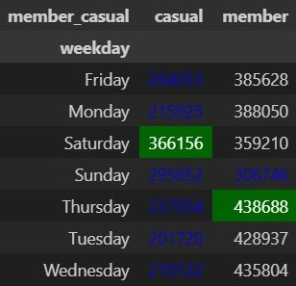
Average ride lengths (seconds)
Members vs Casual Users during weekdays.
Members ride length is higher during the week. Potentially work commuters.
Casual riders ride length is above average only on Saturdays.
Sundays represent below average ride length for both types of users.

Slide 9
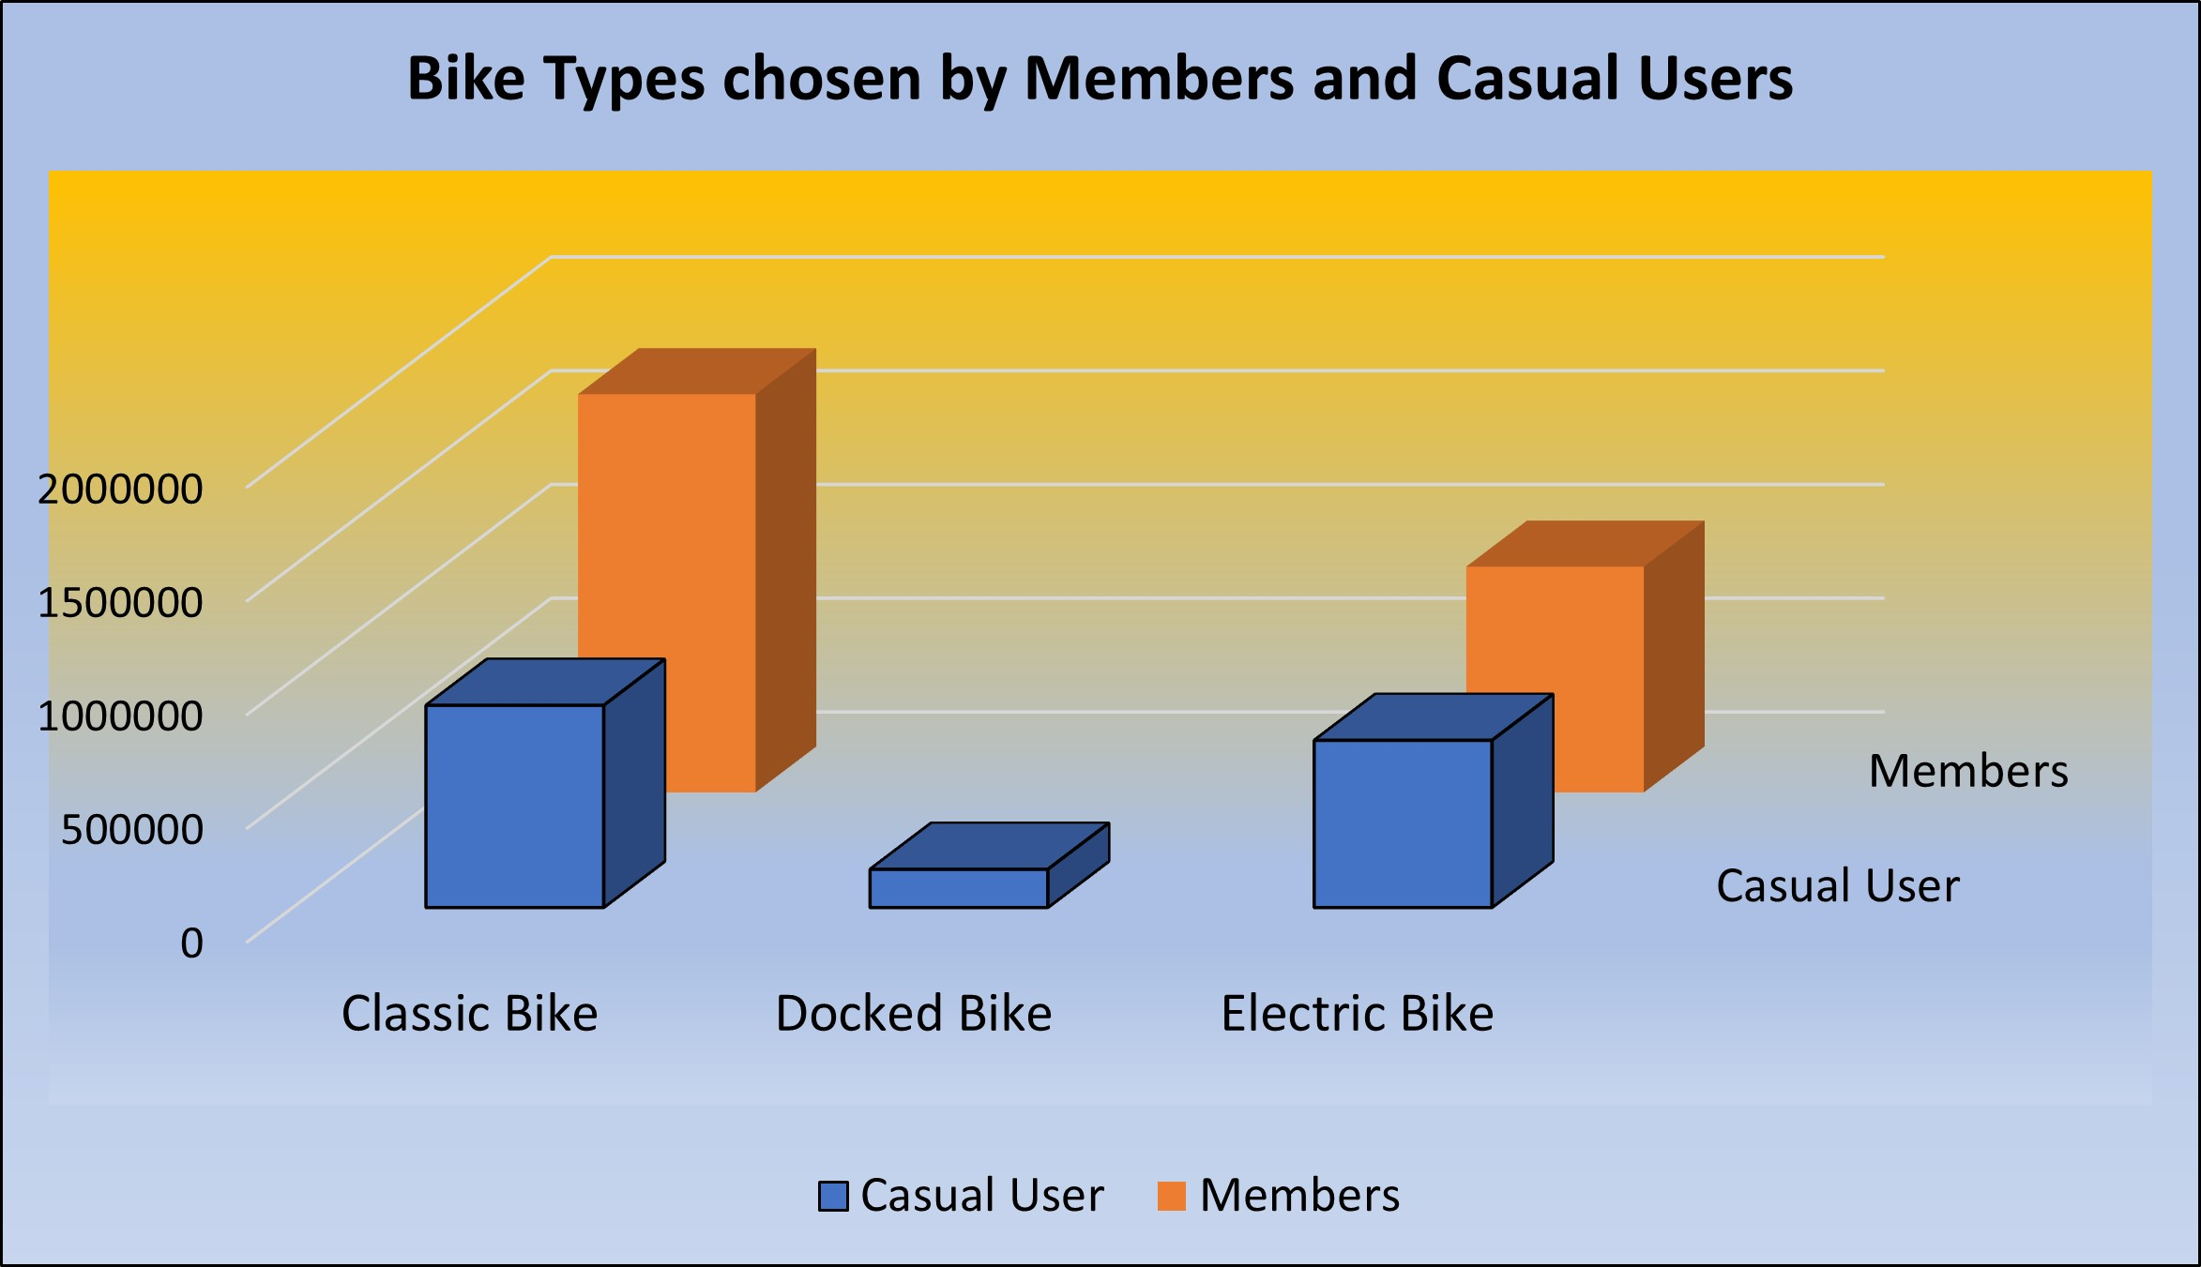
Bike Types chosen by riders
Classic bikes are the most popular for both types of riders.
Docked bikes are only popular for Casual Users.

Slide 10

conclusions
Bike rides have a direct relationship with the seasons.
Members ride more often during the week, perhaps work commuters.
Casual members double and nearly match Members during the weekends.
Classic bikes are the most popular types of bike for both types of users.
Ride lengths are close to average for members during the week.
Ride lengths are below average for Casual Users during the week, except for Saturdays.

Slide 11

recommendations
Acquire more casual bikes and discontinue docked bikes.
Offer seasonal memberships for Casual riders.
Offer weekend memberships to attract Casual riders.
Stock unused bikes during winter to preserve them.
Offer discount passes for cold seasons.

Slide 12
Thank you for attending!
Contact lines:
https://www.linkedin.com/in/brian-kevin-sampera-54211128/
https://github.com/BKSDA/BKSDA.github.io
https://www.youtube.com/channel/UC8EK7m2ovc8Bzf54RESpvxA

